Slide 1
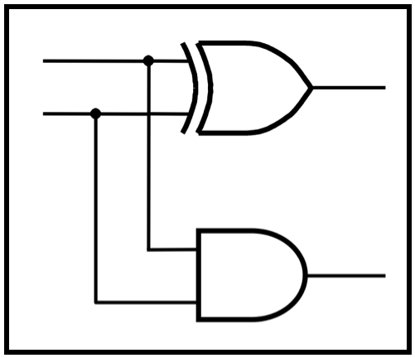
CprE 281:
Digital Logic
Instructor: Alexander Stoytchev
http://www.ece.iastate.edu/~alexs/classes/

Slide 2
Multiplexers
CprE 281: Digital Logic
Iowa State University, Ames, IA
Copyright © Alexander Stoytchev

Slide 3
Administrative Stuff
HW 6 is due on Monday

Slide 4
Administrative Stuff
HW 7 is out
It is due on Monday Oct 17 @ 4pm

Slide 5
2-1 Multiplexer (Definition)
Has two inputs: x₁ and x₂
Also has another input line s
If s=0, then the output is equal to x₁
If s=1, then the output is equal to x₂

Slide 6
Graphical Symbol for a 2-1 Multiplexer
s
x
0
1
f
x
1
2
[ Figure 2.33c from the textbook ]

Slide 7
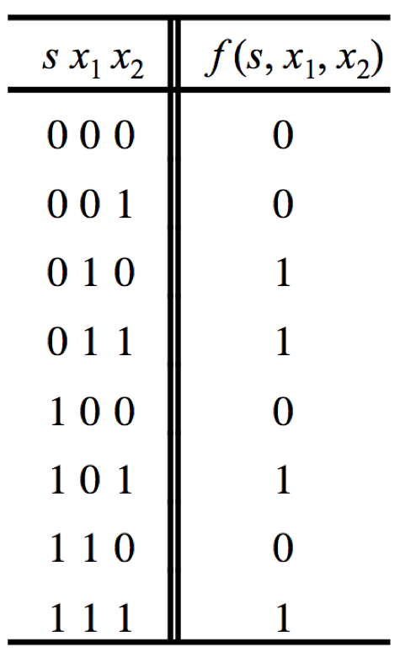
Truth Table for a 2-1 Multiplexer
[ Figure 2.33a from the textbook ]

Slide 8
Let’s Derive the SOP form

Slide 9
Let’s Derive the SOP form

Slide 10
Let’s Derive the SOP form
Where should we
put the negation signs?
s x₁ x₂
s x₁ x₂
s x₁ x₂
s x₁ x₂

Slide 11
Let’s Derive the SOP form
s x₁ x₂
s x₁ x₂
s x₁ x₂
s x₁ x₂

Slide 12
Let’s Derive the SOP form
s x₁ x₂
s x₁ x₂
s x₁ x₂
s x₁ x₂
f (s, x_{1,} x₂) =
s x₁ x₂
+
s x₁ x₂
+
s x₁ x₂
+
s x₁ x₂

Slide 13
Let’s simplify this expression
f (s, x_{1,} x₂) =
s x₁ x₂
+
s x₁ x₂
+
s x₁ x₂
+
s x₁ x₂

Slide 14
Let’s simplify this expression
f (s, x_{1,} x₂) =
s x₁ x₂
+
s x₁ x₂
+
s x₁ x₂
+
s x₁ x₂
f (s, x_{1,} x₂) =
s x₁ (x₂ + x₂)
+
+
s (x₁ +x₁ )x₂

Slide 15
Let’s simplify this expression
f (s, x_{1,} x₂) =
s x₁ x₂
+
s x₁ x₂
+
s x₁ x₂
+
s x₁ x₂
f (s, x_{1,} x₂) =
s x₁ (x₂ + x₂)
+
+
s (x₁ +x₁ )x₂
f (s, x_{1,} x₂) =
s x₁
+
s x₂

Slide 16
Circuit for 2-1 Multiplexer
x
s
1
f
x
1
0
f
s
x
2
1
x
2
(b) Circuit
(c) Graphical symbol
f (s, x_{1,} x₂) =
s x₁
+
s x₂
[ Figure 2.33b-c from the textbook ]

Slide 17
Analysis of the 2-1 Multiplexer
(when the input s=0)
x₁
x₁
1
x₁
f
s
0
0
x₂
0

Slide 18
Analysis of the 2-1 Multiplexer
(when the input s=1)
x₁
0
0
x₂
f
s
1
1
x₂
x₂

Slide 19
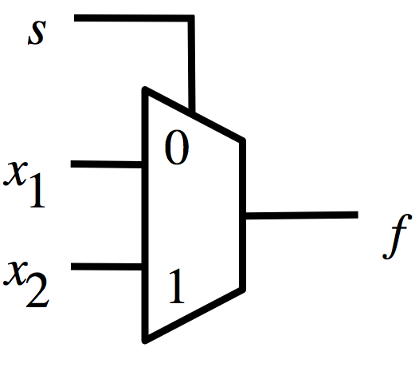
Analysis of the 2-1 Multiplexer
(when the input s=0)
0
x₁

Slide 20
Analysis of the 2-1 Multiplexer
(when the input s=1)
1
x₂

Slide 21
More Compact Truth-Table Representation
s
x₁
x₂
f (s, x₁, x₂)
0
0
0
0
0
0
1
0
s
f (s, x₁, x₂)
0
1
0
1
0
x₁
0
1
1
1
1
x₂
1
0
0
0
1
0
1
1
1
1
0
0
1
1
1
1
(a)
Truth
table
[ Figure 2.33 from the textbook ]

Slide 22
4-1 Multiplexer (Definition)
Has four inputs: w₀ , w₁, w₂, w₃
Also has two select lines: s₁ and s₀
If s₁=0 and s₀=0, then the output f is equal to w₀
If s₁=0 and s₀=1, then the output f is equal to w₁
If s₁=1 and s₀=0, then the output f is equal to w₂
If s₁=1 and s₀=1, then the output f is equal to w₃

Slide 23
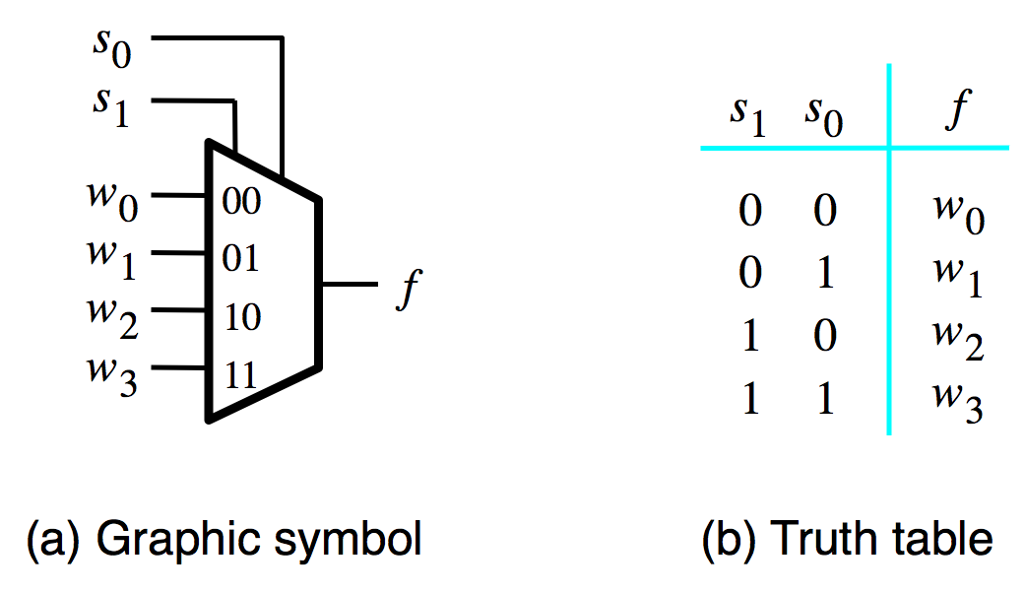
Graphical Symbol and Truth Table
[ Figure 4.2a-b from the textbook ]

Slide 24
The long-form truth table

Slide 25
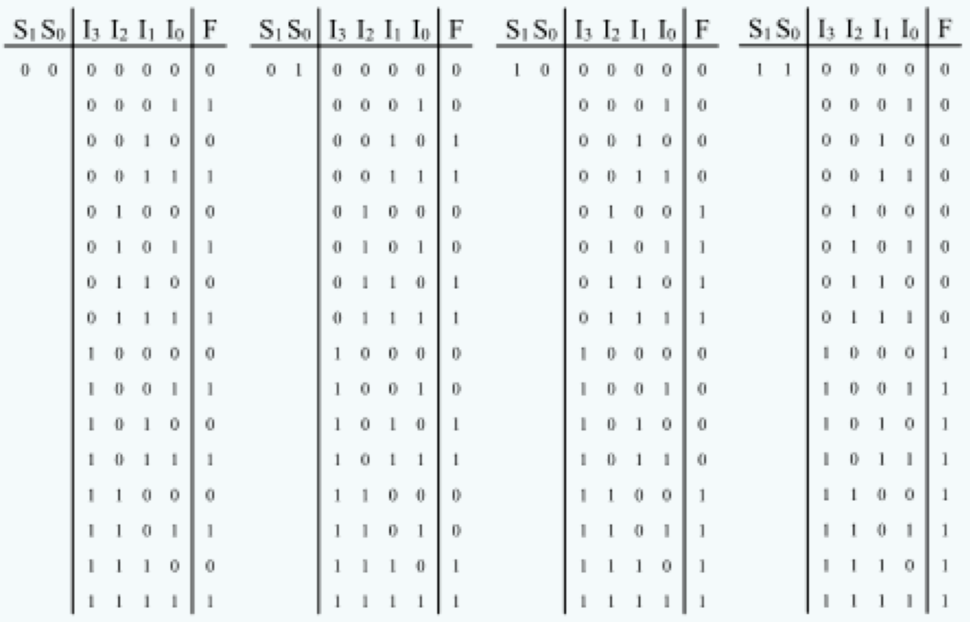
The long-form truth table
[http://www.absoluteastronomy.com/topics/Multiplexer]

Slide 26
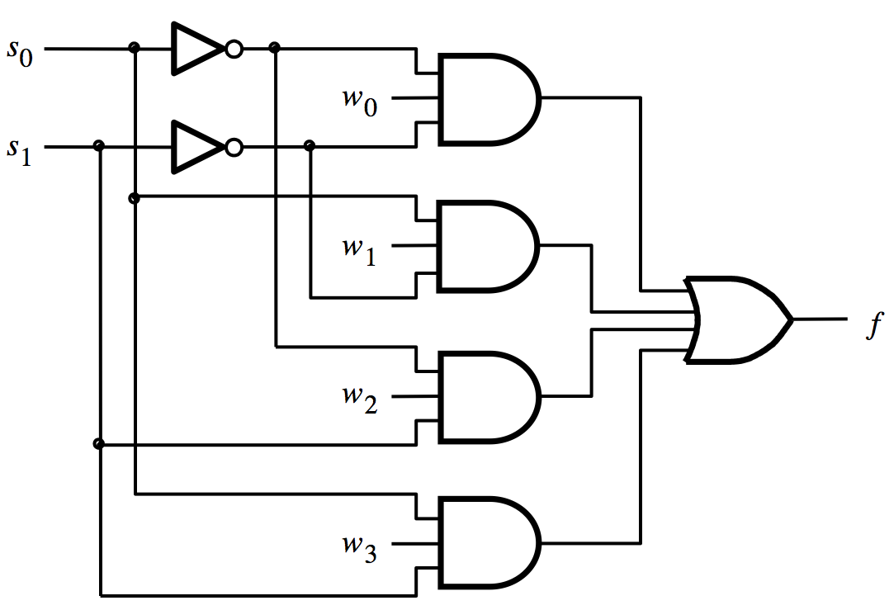
4-1 Multiplexer (SOP circuit)
f = s₁ s₀ w₀ + s₁ s₀ w₁ + s₁ s₀ w₂ + s₁ s₀ w₃
[ Figure 4.2c from the textbook ]

Slide 27
Analysis of the 4-1 Multiplexer
( s₁=0 and s₀=0 )
0
0

Slide 28
Analysis of the 4-1 Multiplexer
( s₁=0 and s₀=0 )
0
1
0
1
0
1
1
0
0
0

Slide 29
Analysis of the 4-1 Multiplexer
( s₁=0 and s₀=0 )
0
1
w₀
0
1
0
0
1
1
0
0
0
0
0

Slide 30
Analysis of the 4-1 Multiplexer
( s₁=0 and s₀=0 )
0
1
w₀
0
1
0
0
1
w₀
1
0
0
0
0
0

Slide 31
Analysis of the 4-1 Multiplexer
( s₁=0 and s₀=1 )
1
0
0
0
1
1
w₁
1
w₁
0
0
0
1
0
0

Slide 32
Analysis of the 4-1 Multiplexer
( s₁=1 and s₀=0 )
0
1
0
1
0
0
0
0
w₂
1
w₂
1
0
0
1

Slide 33
Analysis of the 4-1 Multiplexer
( s₁=1 and s₀=1 )
1
0
0
1
0
1
0
0
w₃
0
0
1
1
w₃
1

Slide 34
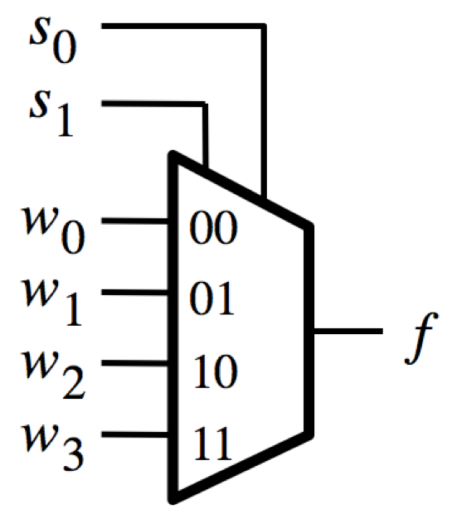
Analysis of the 4-1 Multiplexer
( s₁=0 and s₀=0 )
0
0
w₀

Slide 35
Analysis of the 4-1 Multiplexer
( s₁=0 and s₀=1 )
1
0
w₁

Slide 36
Analysis of the 4-1 Multiplexer
( s₁=1 and s₀=0 )
0
1
w₂

Slide 37
Analysis of the 4-1 Multiplexer
( s₁=1 and s₀=1 )
1
1
w₃

Slide 38
Using three 2-to-1 multiplexers
to build one 4-to-1 multiplexer
s
1
s
0
w
0
0
w
1
1
0
f
1
w
2
0
w
3
1
[ Figure 4.3 from the textbook ]

Slide 39
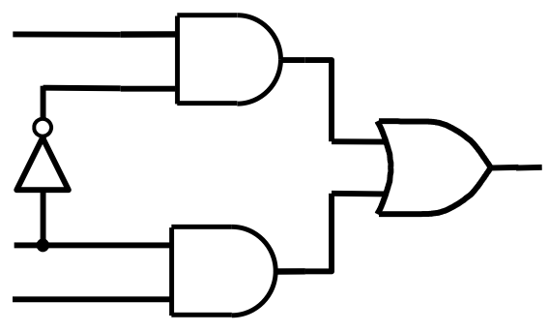
Using three 2-to-1 multiplexers
to build one 4-to-1 multiplexer

Slide 40
Using three 2-to-1 multiplexers
to build one 4-to-1 multiplexer

Slide 41
Using three 2-to-1 multiplexers
to build one 4-to-1 multiplexer

Slide 42
Using three 2-to-1 multiplexers
to build one 4-to-1 multiplexer
w₀
w₁
s₁
f
s₀
w₂
w₃

Slide 43
That is different from the SOP form of the 4-1 multiplexer shown below, which uses less gates

Slide 44
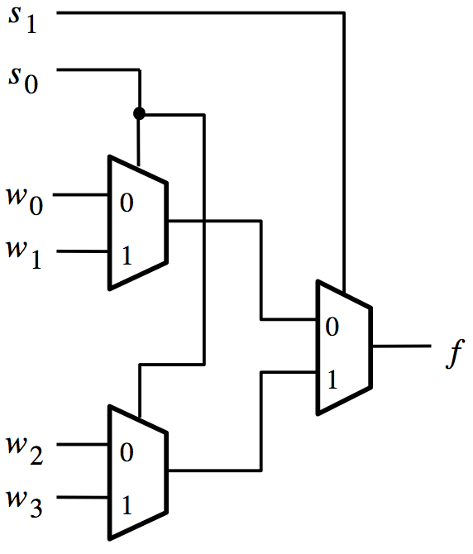
Analysis of the Hierarchical Implementation
( s₁=0 and s₀=0 )
0
0
0
0
w₀
0
[ Figure 4.3 from the textbook ]

Slide 45
Analysis of the Hierarchical Implementation
( s₁=0 and s₀=1 )
0
1
1
0
w₁
1
[ Figure 4.3 from the textbook ]

Slide 46
Analysis of the Hierarchical Implementation
( s₁=1 and s₀=0 )
1
0
0
1
w₂
0
[ Figure 4.3 from the textbook ]

Slide 47
Analysis of the Hierarchical Implementation
( s₁=1 and s₀=1 )
1
1
1
1
w₃
1
[ Figure 4.3 from the textbook ]

Slide 48
16-1 Multiplexer
s
0
s
1
w
0
w
3
w
4
s
2
s
3
w
7
f
w
8
w
11
w
12
w
15
[ Figure 4.4 from the textbook ]

Slide 49
Multiplexers Are Special

Slide 50
The Three Basic Logic Gates
x
1
x
⋅
x
1
x
x
1
x
2
x
1
+
x
2
x
2
x
2
NOT gate
AND gate
OR gate
[ Figure 2.8 from the textbook ]

Slide 51
Truth Table for NOT
x
x
x
x
0
1
1
0

Slide 52
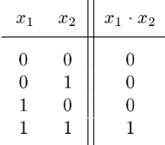
Truth Table for AND
x
1
x
⋅
1
x
2
x
2

Slide 53
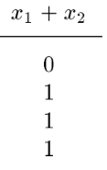
Truth Table for OR
x
1
x
x
1
+
x
2
2

Slide 54
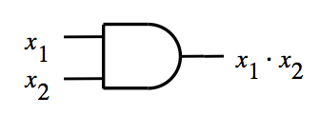
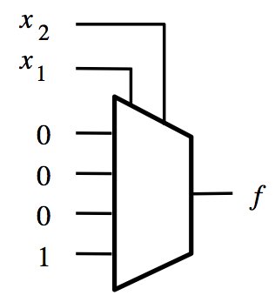
Building an AND Gate with 4-to-1 Mux

Slide 55
Building an AND Gate with 4-to-1 Mux
These two are the same.

Slide 56
Building an AND Gate with 4-to-1 Mux
These two are the same.
And so are these two.

Slide 57
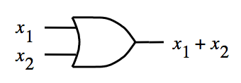
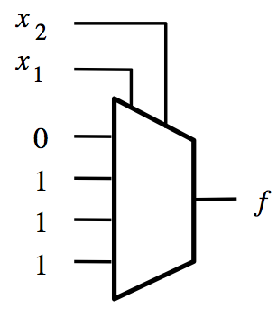
Building an OR Gate with 4-to-1 Mux

Slide 58
Building an OR Gate with 4-to-1 Mux
These two are the same.

Slide 59
Building an OR Gate with 4-to-1 Mux
These two are the same.
And so are these two.

Slide 60
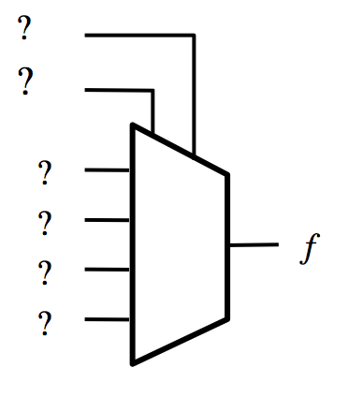
Building a NOT Gate with 4-to-1 Mux
x
x
x
x
0
1
1
0

Slide 61
Building a NOT Gate with 4-to-1 Mux
x
x
x | y | f
0 | 0 | 1
0 | 1 | 1
1 | 0 | 0
1 | 1 | 0
Introduce a dummy variable y.

Slide 62
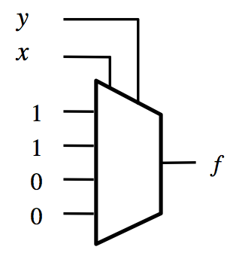
Building a NOT Gate with 4-to-1 Mux
x
x
x | y | f
0 | 0 | 1
0 | 1 | 1
1 | 0 | 0
1 | 1 | 0

Slide 63
Building a NOT Gate with 4-to-1 Mux
x
x
x | y | f
0 | 0 | 1
0 | 1 | 1
1 | 0 | 0
1 | 1 | 0
Now set y to either 0 or 1 (both will work). Why?

Slide 64
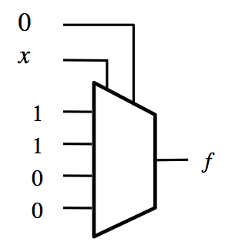
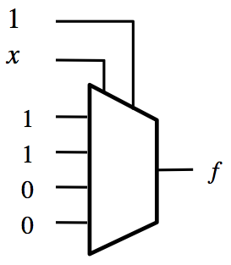
Building a NOT Gate with 4-to-1 Mux
x
x
x
x
0
1
1
0
Two alternative solutions.

Slide 65
Implications
Any Boolean function can be implemented
using only 4-to-1 multiplexers!

Slide 66
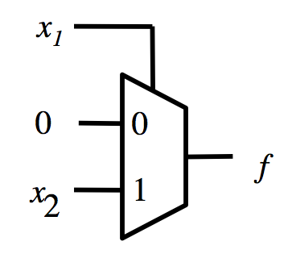
Building an AND Gate with 2-to-1 Mux

Slide 67
Building an AND Gate with 2-to-1 Mux

Slide 68
Building an AND Gate with 2-to-1 Mux
0
x₂

Slide 69
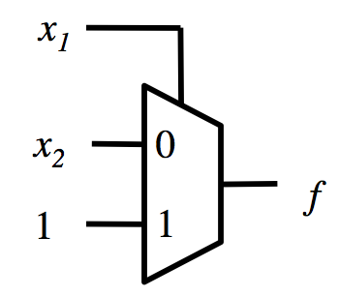
Building an OR Gate with 2-to-1 Mux

Slide 70
Building an OR Gate with 2-to-1 Mux

Slide 71
Building an OR Gate with 2-to-1 Mux
x₂
1

Slide 72
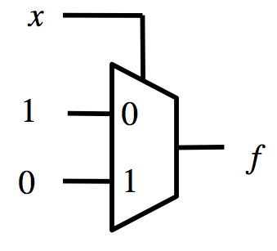
Building a NOT Gate with 2-to-1 Mux
x
x
x
x
0
1
1
0

Slide 73
Building a NOT Gate with 2-to-1 Mux
x
x
x
x
0
1
1
0

Slide 74
Implications
Any Boolean function can be implemented
using only 2-to-1 multiplexers!

Slide 75
Synthesis of Logic Circuits
Using Multiplexers

Slide 76
2 x 2 Crossbar switch
s
x
1
y
1
x
2
y
2
[ Figure 4.5a from the textbook ]

Slide 77
2 x 2 Crossbar switch
s=0
x
1
y
1
x
2
y
2
s=1
x
1
y
1
x
2
y
2

Slide 78
Implementation of a 2 x 2 crossbar switch with multiplexers
x
1
0
y
1
1
s
x
2
0
y
2
1
[ Figure 4.5b from the textbook ]

Slide 79
Implementation of a 2 x 2 crossbar switch with multiplexers

Slide 80
Implementation of a 2 x 2 crossbar switch with multiplexers
x₁
y₁
s
x₂
y₂

Slide 81
Implementation of a logic function with a 4x1 multiplexer
w
w
f
w
2
1
2
w
1
0
0
0
0
0
1
1
1
1
0
1
1
f
1
1
0
0
[ Figure 4.6a from the textbook ]

Slide 82
Implementation of the same logic function with a 2x1 multiplexer
w
1
w
2
f
w
f
1
w
0
0
0
w
1
0
2
0
1
1
w
w
1
2
2
1
0
1
f
1
1
0
(b) Modified truth table
(c) Circuit
[ Figure 4.6b-c from the textbook ]

Slide 83
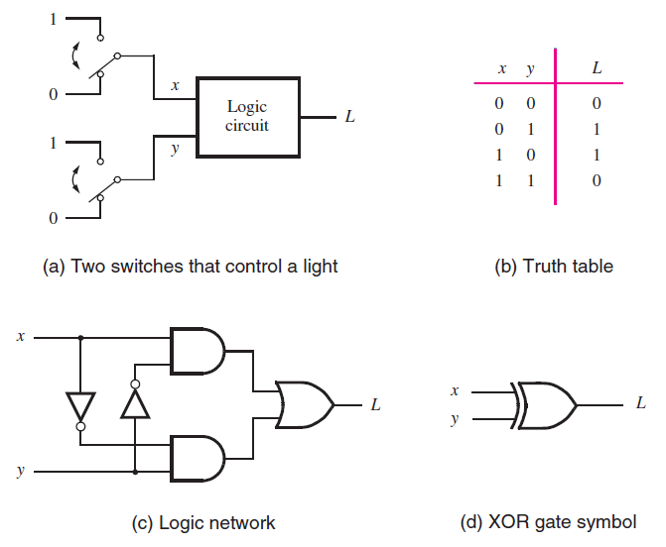
The XOR Logic Gate
[ Figure 2.11 from the textbook ]

Slide 84
The XOR Logic Gate
[ Figure 2.11 from the textbook ]

Slide 85
Implementation of the XOR Logic Gate with a 2-to-1 multiplexer and one NOT
f

Slide 86

Implementation of the XOR Logic Gate with a 2-to-1 multiplexer and one NOT
x
f
y

Slide 87
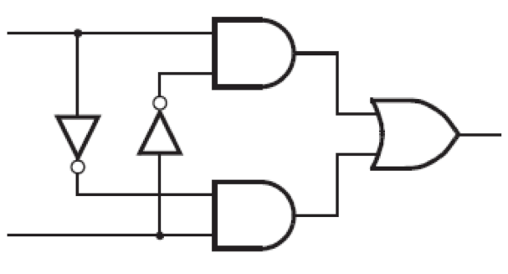
Implementation of the XOR Logic Gate with a 2-to-1 multiplexer and one NOT
x
f
y
These two circuits are equivalent
(the wires of the bottom AND gate are flipped)

Slide 88

In other words,
all four of these are equivalent!
x
y
f
x
f
y
w
2
w
1
x
0
1
f
y
f
1
0

Slide 89
Implementation of another logic function
w
1
w
2
w
3
f
0
0
0
0
0
0
1
0
0
1
0
0
0
1
1
1
1
0
0
0
1
0
1
1
1
1
0
1
1
1
1
1
[ Figure 4.7 from the textbook ]

Slide 90
Implementation of another logic function
w
1
w
2
w
3
f
0
0
0
0
0
0
1
0
0
1
0
0
0
1
1
1
1
0
0
0
1
0
1
1
1
1
0
1
1
1
1
1
[ Figure 4.7 from the textbook ]

Slide 91
Implementation of another logic function
w
1
w
2
w
3
f
w
1
w
2
f
0
0
0
0
0
0
0
1
0
0
0
0
1
w
3
0
1
0
0
1
0
w
3
0
1
1
1
1
1
1
1
0
0
0
1
0
1
1
1
1
0
1
1
1
1
1
[ Figure 4.7 from the textbook ]

Slide 92
Implementation of another logic function
w
1
w
2
w
3
f
w
2
w
1
w
2
f
w
0
0
0
0
1
0
0
0
0
0
0
1
0
0
1
w
w
3
3
f
0
1
0
0
1
0
w
3
0
1
1
1
1
1
1
1
1
0
0
0
1
0
1
1
1
1
0
1
1
1
1
1
[ Figure 4.7 from the textbook ]

Slide 93
Another Example
(3-input XOR)

Slide 94
Implementation of 3-input XOR with 2-to-1 Multiplexers
w
1
w
2
w
3
f
0
0
0
0
0
0
1
1
0
1
0
1
0
1
1
0
1
0
0
1
1
0
1
0
1
1
0
0
1
1
1
1
[ Figure 4.8a from the textbook ]

Slide 95
Implementation of 3-input XOR with 2-to-1 Multiplexers
w
1
w
2
w
3
f
0
0
0
0
0
0
1
1
w
⊕
w
0
1
0
1
2
3
0
1
1
0
1
0
0
1
1
0
1
0
w
⊕
w
1
1
0
0
2
3
1
1
1
1
[ Figure 4.8a from the textbook ]

Slide 96
Implementation of 3-input XOR with 2-to-1 Multiplexers
w
1
w
2
w
3
f
0
0
0
0
0
0
1
1
w
⊕
w
0
1
0
1
2
3
w
1
0
1
1
0
w
⊕
w
1
0
0
1
2
3
f
1
0
1
0
w
⊕
w
1
1
0
0
2
3
1
1
1
1
(a) Truth table
(b) Circuit
[ Figure 4.8 from the textbook ]

Slide 97
Implementation of 3-input XOR with 2-to-1 Multiplexers
w
1
w
2
w
3
f
0
0
0
0
w₃
0
0
1
1
w
0
1
0
1
w₃
2
w
1
0
1
1
0
w
3
1
0
0
1
f
1
0
1
0
1
1
0
0
1
1
1
1
(a) Truth table
(b) Circuit
[ Figure 4.8 from the textbook ]

Slide 98
Implementation of 3-input XOR
with a 4-to-1 Multiplexer
w
1
w
2
w
3
f
0
0
0
0
0
0
1
1
0
1
0
1
0
1
1
0
1
0
0
1
1
0
1
0
1
1
0
0
1
1
1
1
[ Figure 4.9a from the textbook ]

Slide 99
Implementation of 3-input XOR
with a 4-to-1 Multiplexer
w
1
w
2
w
3
f
0
0
0
0
0
0
1
1
0
1
0
1
0
1
1
0
1
0
0
1
1
0
1
0
1
1
0
0
1
1
1
1
[ Figure 4.9a from the textbook ]

Slide 100
Implementation of 3-input XOR
with a 4-to-1 Multiplexer
w
1
w
2
w
3
f
0
0
0
0
w
0
0
1
1
3
0
1
0
1
w
0
1
1
0
3
1
0
0
1
w
1
0
1
0
3
1
1
0
0
w
1
1
1
1
3
[ Figure 4.9a from the textbook ]

Slide 101
Implementation of 3-input XOR
with a 4-to-1 Multiplexer
w
1
w
2
w
3
f
0
0
0
0
w
0
0
1
1
3
w
2
w
1
0
1
0
1
w
0
1
1
0
3
w
3
1
0
0
1
w
f
1
0
1
0
3
1
1
0
0
w
1
1
1
1
3
(a) Truth table
(b) Circuit
[ Figure 4.9 from the textbook ]

Slide 102
Multiplexor Synthesis
Using Shannon’s Expansion

Slide 103
Three-input majority function
w
1
w
2
w
3
f
0
0
0
0
0
0
1
0
0
1
0
0
0
1
1
1
1
0
0
0
1
0
1
1
1
1
0
1
1
1
1
1
[ Figure 4.10a from the textbook ]

Slide 104
Three-input majority function
w
1
w
2
w
3
f
0
0
0
0
w
1
f
0
0
1
0
0
0
1
0
0
1
0
1
1
1
1
0
0
0
1
0
1
1
1
1
0
1
1
1
1
1
[ Figure 4.10a from the textbook ]

Slide 105
Three-input majority function
w
1
w
2
w
3
f
0
0
0
0
w
1
f
0
0
1
0
w
w
0
2
3
0
1
0
0
1
w
+
w
0
1
1
1
2
3
1
0
0
0
1
0
1
1
1
1
0
1
1
1
1
1
[ Figure 4.10a from the textbook ]

Slide 106
Three-input majority function
w
1
w
2
w
3
f
0
0
0
0
w
1
f
0
0
1
0
w
w
0
2
3
0
1
0
0
1
w
+
w
0
1
1
1
2
3
1
0
0
0
1
0
1
1
1
1
0
1
1
1
1
1
(b) Truth table
w
w
1
2
w
3
f
(b) Circuit
[ Figure 4.10a from the textbook ]

Slide 107

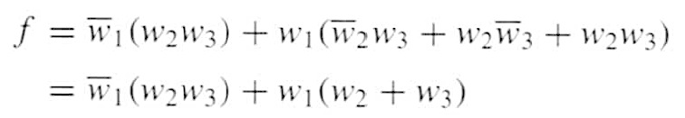
Three-input majority function
w
w
1
2
w
3
f

Slide 108

Shannon’s Expansion Theorem
Any Boolean function can be rewritten in the form:

Slide 109

Shannon’s Expansion Theorem
Any Boolean function can be rewritten in the form:

Slide 110
Shannon’s Expansion Theorem
Any Boolean function can be rewritten in the form:
cofactor
cofactor

Slide 111
Shannon’s Expansion Theorem
(Example)

Slide 112
Shannon’s Expansion Theorem
(Example)
(w₁ + w₁)

Slide 113
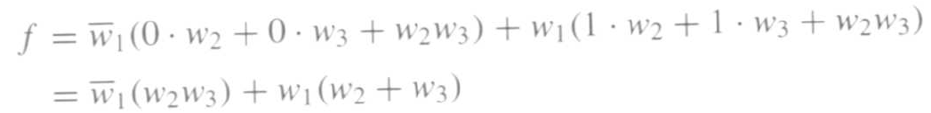
Shannon’s Expansion Theorem
(Example)
(w₁ + w₁)

Slide 114
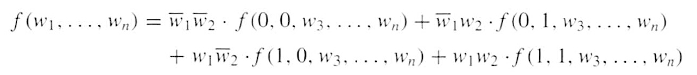
Shannon’s Expansion Theorem
(In terms of more than one variable)
This form is suitable for implementation with a 4x1 multiplexer.

Slide 115
Another Example

Slide 116

Factor and implement the following function with a 2x1 multiplexer

Slide 117
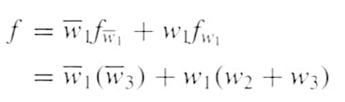
Factor and implement the following function with a 2x1 multiplexer

Slide 118
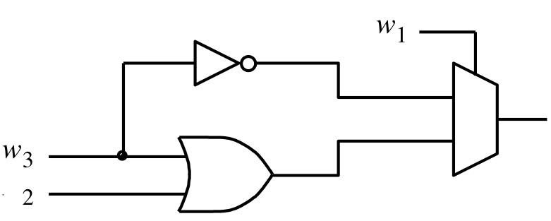
Factor and implement the following function with a 2x1 multiplexer
f
w
[ Figure 4.11a from the textbook ]

Slide 119
Factor and implement the following function with a 4x1 multiplexer

Slide 120
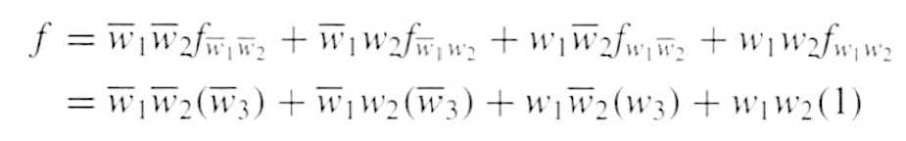
Factor and implement the following function with a 4x1 multiplexer

Slide 121
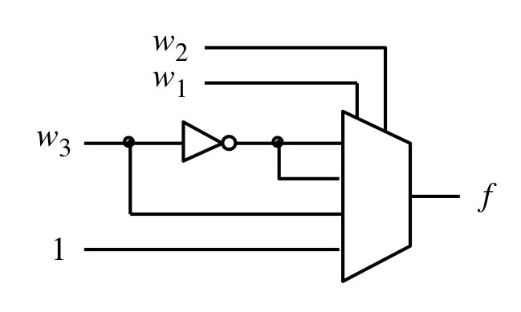
Factor and implement the following function with a 4x1 multiplexer
[ Figure 4.11b from the textbook ]

Slide 122
Yet Another Example

Slide 123

Factor and implement the following function using only 2x1 multiplexers

Slide 124
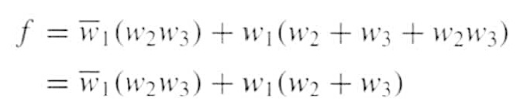
Factor and implement the following function using only 2x1 multiplexers

Slide 125


Factor and implement the following function using only 2x1 multiplexers

Slide 126
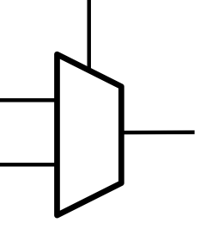
Factor and implement the following function using only 2x1 multiplexers
w₁
g
f
h

Slide 127


Factor and implement the following function using only 2x1 multiplexers

Slide 128


Factor and implement the following function using only 2x1 multiplexers

Slide 129
Factor and implement the following function using only 2x1 multiplexers
w₂
w₂
0
w₃
g
h
w₃
1

Slide 130
Finally, we are ready to draw the circuit
w₂
0
w₁
g
w₃
g
f
w₂
h
w₃
h
1

Slide 131
Finally, we are ready to draw the circuit
w₂
0
g
w₁
w₃
f
1
h

Slide 132
Finally, we are ready to draw the circuit
w
w
2
1
0
w
3
f
1
[ Figure 4.12 from the textbook ]

Slide 133
Questions?

Slide 134
THE END

